Slide 1
GoMentum Station & the Role of Counties in Smart Transportation
John Noel Public Transit Conference
October 13, 2017
Jack Hall, P.E.
ITS CV/AV Program Manager
Contra Costa Transportation Authority/GoMentum Station

Slide 2
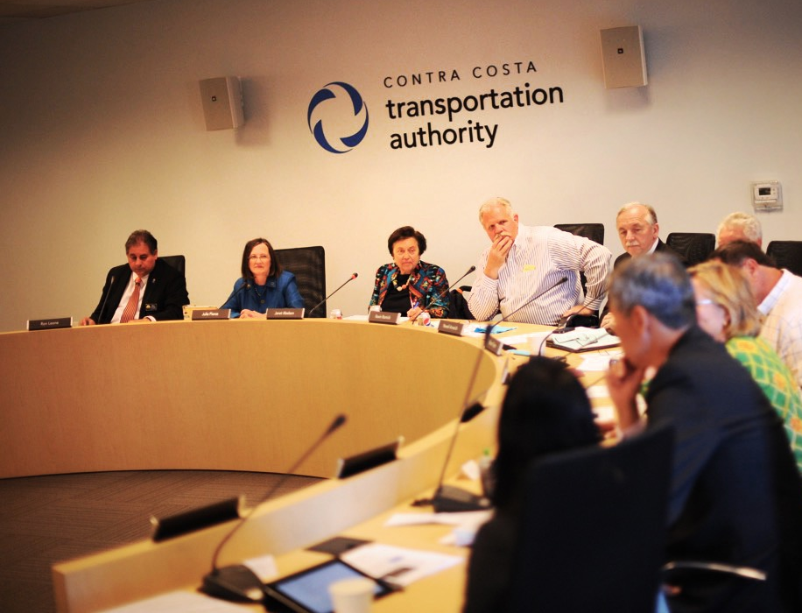
Who We Are
CCTA is a public agency formed by voters in 1988 to manage the county’s transportation sales tax program and to lead transportation planning efforts.
We are responsible for maintaining and improving the county’s transportation system by delivering critical transportation infrastructure projects to safely and efﬁciently get people where they need to go.
Managing entity of autonomous vehicle (AV) testing site: GoMentum Station.

Slide 3
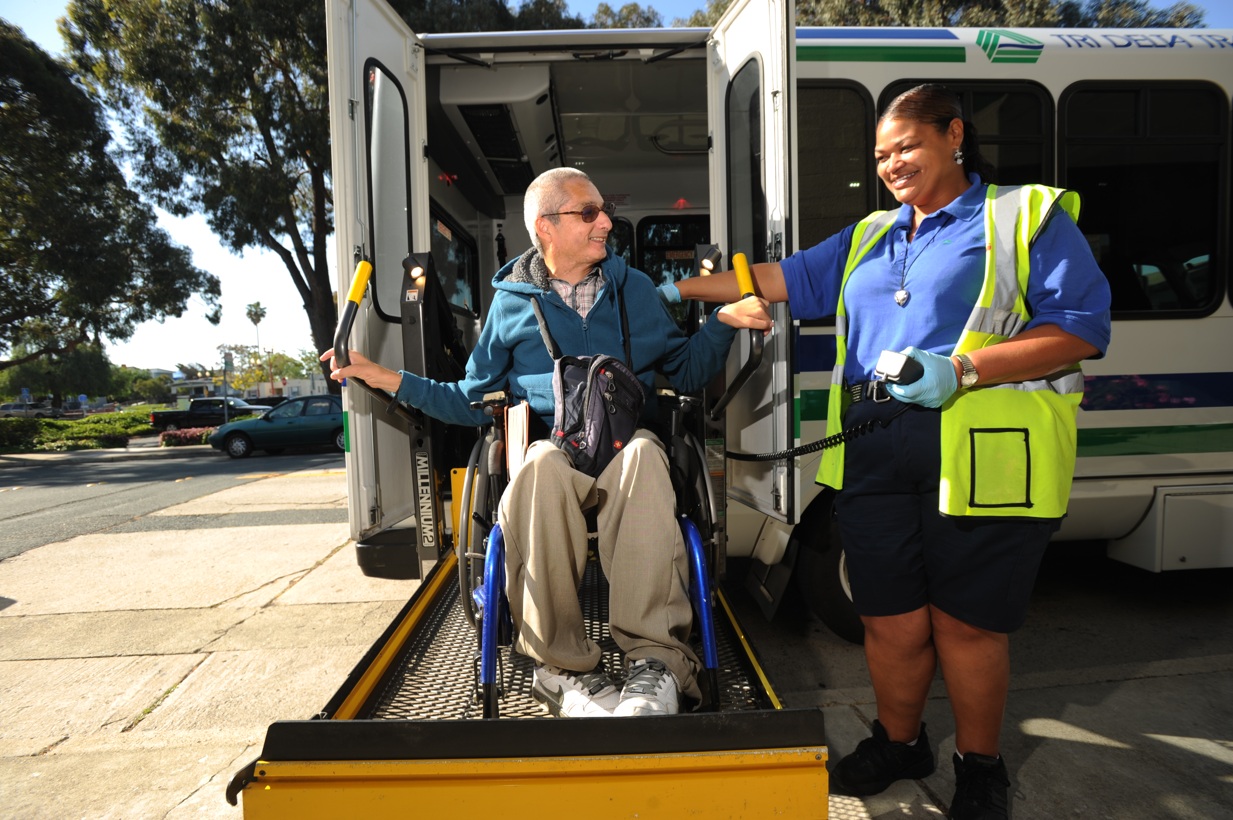
Measure C
Passed by voters in 1988, Measure C provided for a half-cent on the dollar sales tax for 20 years (through March 2009) to pay for an ambitious list of transportation projects and programs.
An estimated $1 billion was generated by this Measure, for a BART extension, freeway improvements, better bus service, enhanced bicycle facilities and more transportation options for senior citizens and people with disabilities.

Slide 4
Measure J
In November 2004, 71% of Contra Costa voters approved Measure J. The measure provided for the continuation of our county’s half-cent transportation sales tax until 2034, and will provide approximately $2.0 billion for countywide and local transportation projects and programs for the life of the measure.

Slide 5
What We Do
PEDESTRIAN Make improvements to sidewalks, crosswalks, trails, and paths
LOCAL STREETS Smooth trafﬁc ﬂow on major roads and invest in improvements such as repairing potholes and road surfaces
BUSES Invest in a reliable, comfortable and convenient bus network
SAFE ROUTES TO SCHOOLS Focus on programs and projects aimed at bicycle and pedestrian safety for K-12 students
FERRIES Expand the Bay Area ferry system by looking to ferries as an alternate commute method between West County and San Francisco
BICYCLE Invest in safe routes and infrastructure improvements for cyclists
BART Improve BART service and stations, extend routes and increase parking at stations
HIGHWAYS Complete Contra Costa’s highway system, and improve air quality and noise protection along these corridors
CARPOOL/RIDESHARE Implement programs to reduce trafﬁc congestion by encouraging carpooling and ridesharing
PROGRAMS FOR SENIORS AND PEOPLE WITH DISABILITIES Enhance transit options to improve mobility for seniors and people with disabilities

Slide 6
Redefining Mobility
ECONOMIC GROWTH & JOB CREATION
EFFICIENT MOBILITY
21ST CENTURY TRANSPORTATION
ENHANCED SAFETY
HEALTHIER ENVIRONMENTS

Slide 7
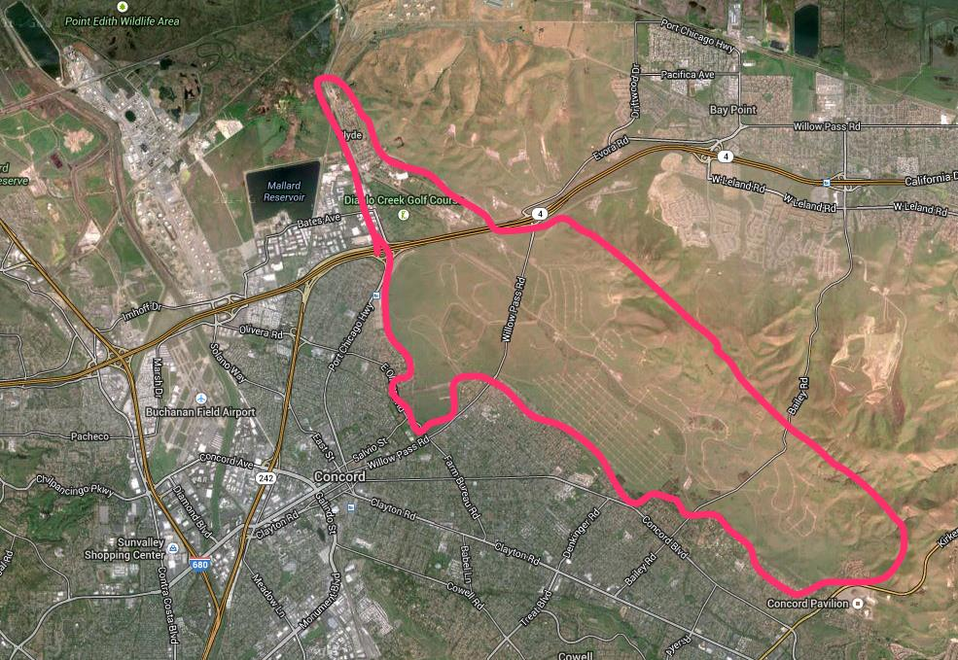
Concord Navy
Weapon Station
Over 5000 acres with 2100 acres available for testing

Slide 8
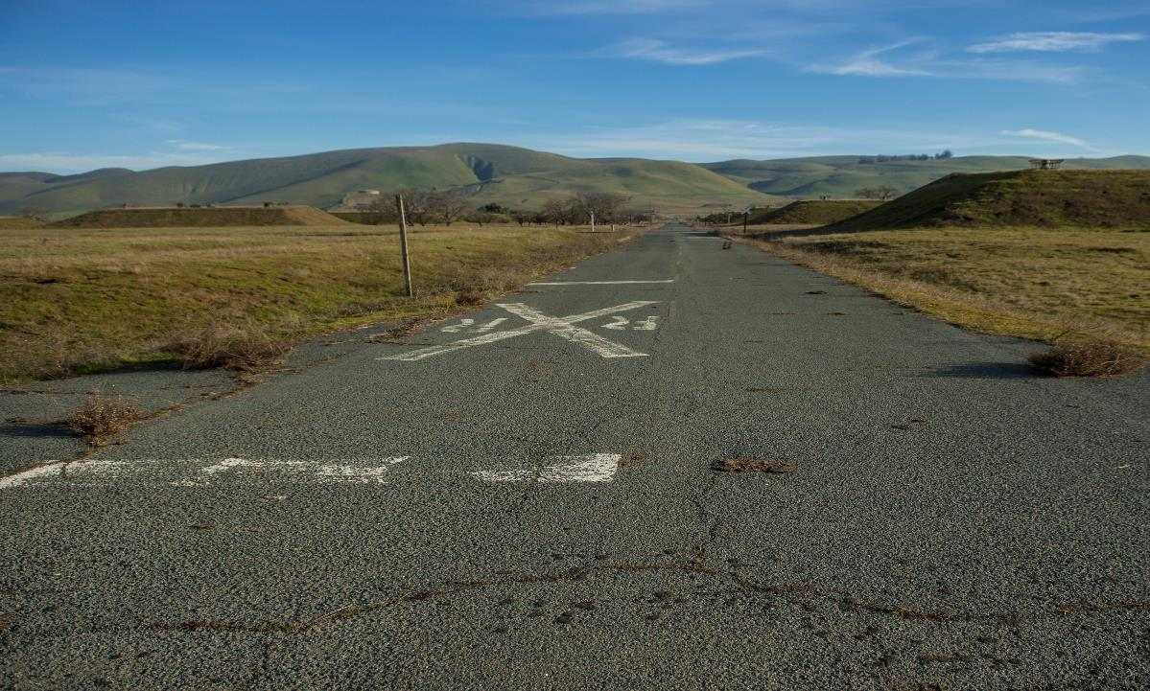
PAVED ROADS
Over 20 miles of paved roadways including a 7-mile long spine road for high speed testing
Additional roadway improvements based on Master Plan

Slide 9
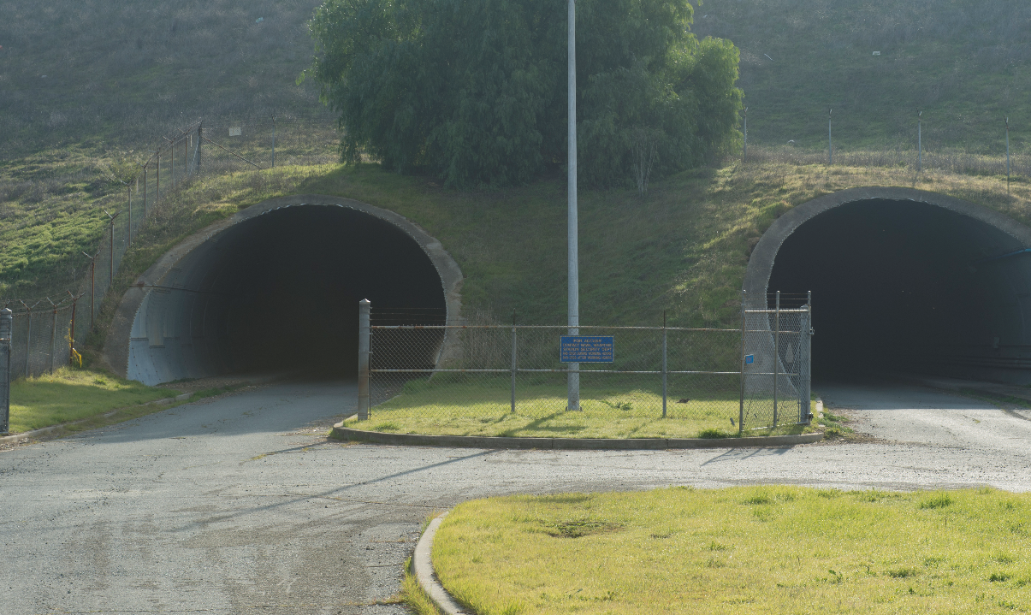
TUNNELS
Two 1400-ft. long tunnels ideal for testing guidance, sensors & communications technologies

Slide 10
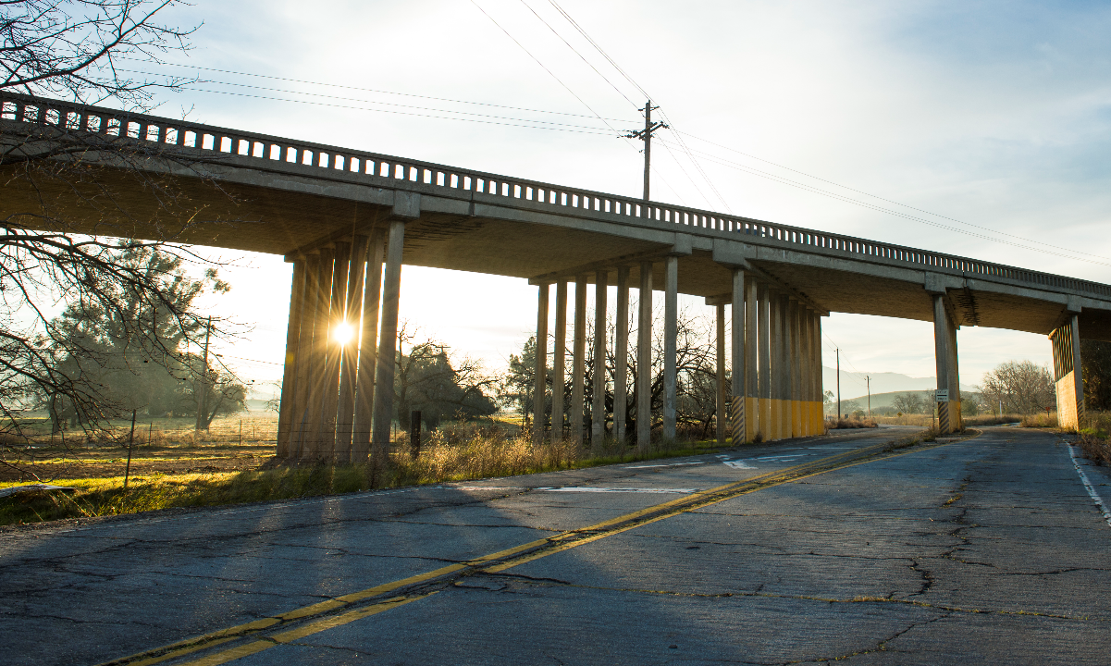
FREEWAY UNDERPASSES
Freeway underpasses and variable roadway geometrics

Slide 11
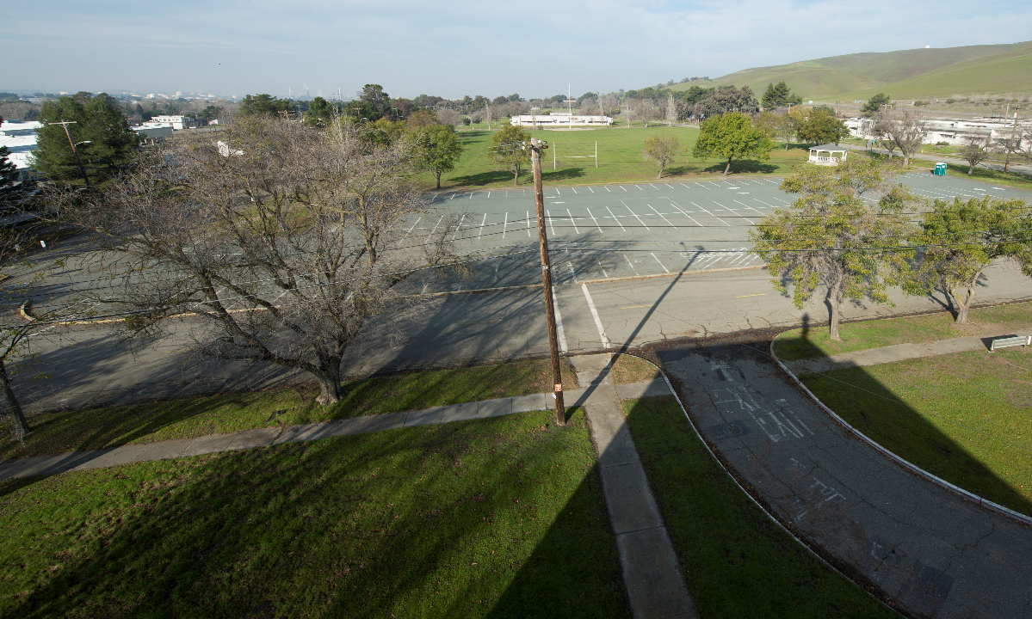
PARKING LOTS
Several parking lots for testing by multiple users

Slide 12
GoMentum Station Vision
Build a CV/AV center at the GoMentum Station where convergence, innovation and commercialization of CV applications and AV technologies take place in the largest testbed in the world

Slide 13
What is GoMentum Station? A Platform for Transforming the Future
Largest Test Bed
Collaboration/Facilitation
Platform
Center for
Innovation
Testing & Research
CV Applications
Redefining Mobility
USDOT Designated Proving Ground Site

Slide 14
GoMentum Station Macro Environment
Challenges
Influencers
Insurance Carriers
Standards
Inst. &
Societal
AMs/ OEMS
State DOTs
Liability
Older Driver
MPOs
USDOT
Certification
Fleet Mgmt.
DMV
ok
Equity
FCC
Privacy
Tech Leaders
NHTSA
Safety
Bandwidth Deficit
Media
Licensing
D-RIDE
FCW
Wireless Comm
Mobility
3D Mapping
IMA
DSRC
EVAC
EEBL
Sensors
5G & WIFI
Solar
CACC
DNPW
LTA
Fuel Cells
BSW/ LCW
VDT
Telematics
Analytics
GPS
Internet of Things
T-DISP
SPD HARM
I-SIG
Q- WARN
Lidar
Cloud
PRE EMPT
Big Data
Apps
Radar
Applications
Technology

Slide 15
OEMs
Partners
Ecosystem
Tier-1 Suppliers
REVs
Public Agencies
Tech/Comm Firms
Insurance Carriers
Analytics
Research Inst.
Testbeds/AVPGs
Prof. Organizations

Slide 16
We Are a Global AVPG
Canada
Netherlands
USDOT
Japan
China
Singapore
Australia
New Zealand
GoMentum Station is an International Entity

Slide 17
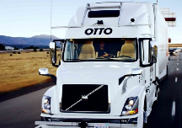
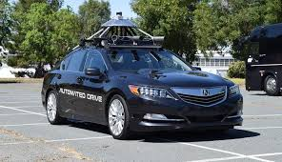
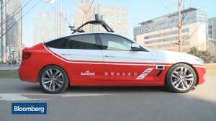
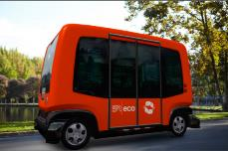
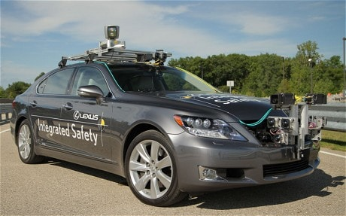
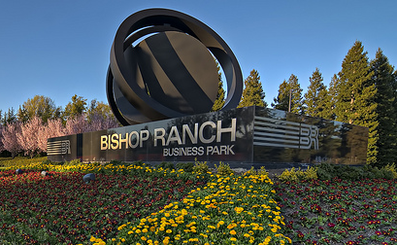
GoMentum Station is Multimodal
Key AM Partners
Testing at GoMentum Station

Slide 18
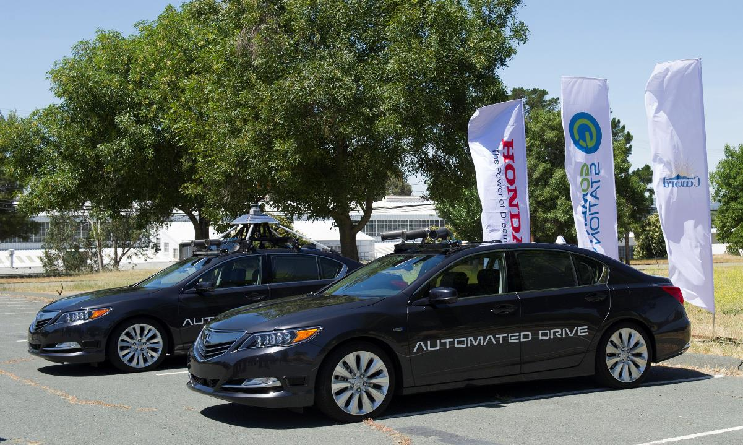
HONDA Research Institute

Slide 19
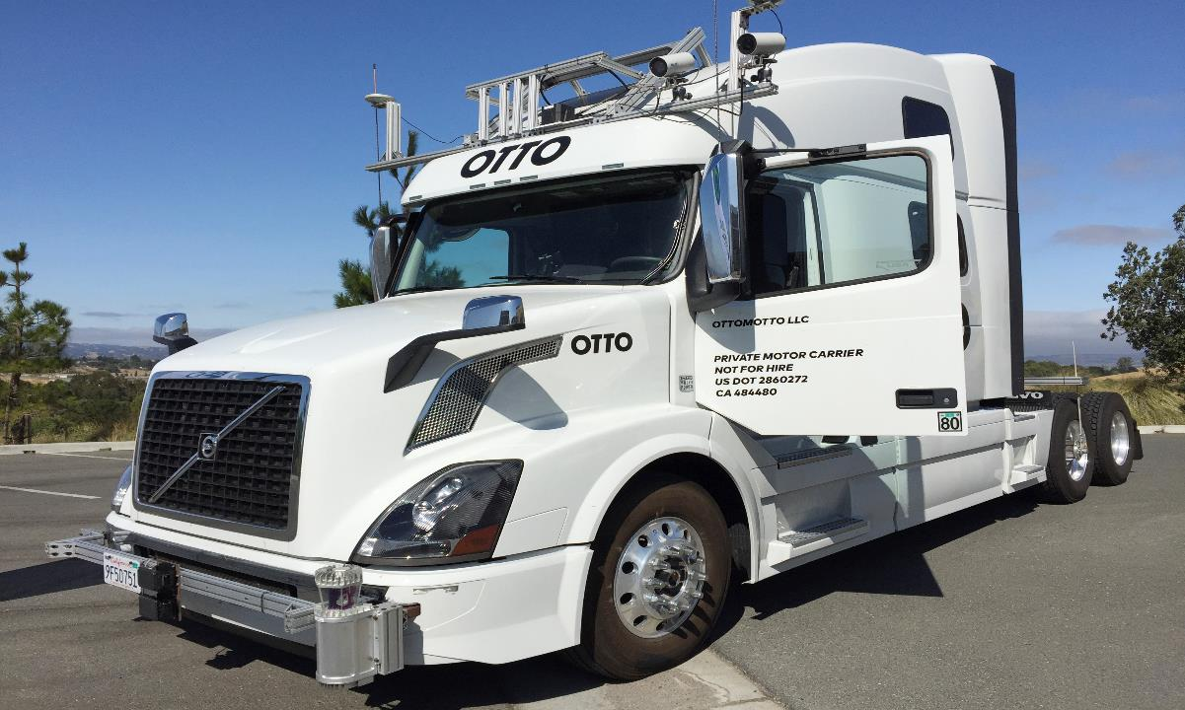
OTTO – UBER Freight

Slide 21
GoMentum Station is a Comprehensive Program
Smart
Corridors
IDTO
Concord
CNWS
Test Facility
Innovate 680
SR-4
ICM
SAV
TDM/511
MaaS

Slide 22
Benefits
Addresses our long-term mobility and safety
Advancements to modernize Transit/Transportation in region
National and International Recognition
Attracts investments, new start-ups, and future funding
Economic vitality for Concord and Contra Costa County
Facilitates partnerships for technology advancements
Provides a forum for public outreach/education regarding advanced technology

Slide 23
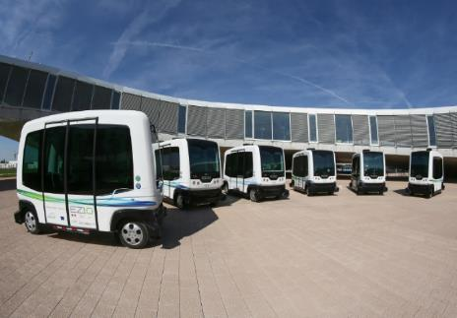
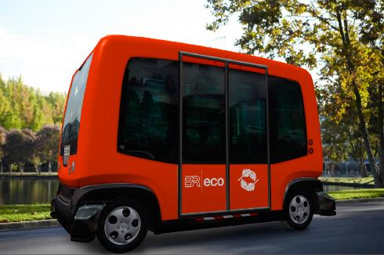
EasyMile
Shared Autonomous Vehicle Project

Slide 24
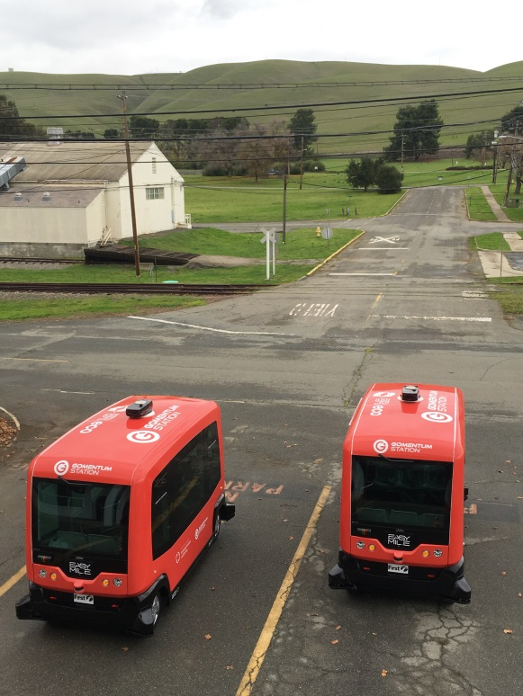
SAV Partners:
Adding:

Slide 25
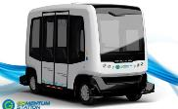
Program Phasing & Schedule
Procurement, Legislative Approval
EasyMile SAV
Bench Testing, Field Operational Testing
and Regulatory Approval
SAV Arrival
in Contra Costa
A
B
C
2016
2017/2018
2019/2020
SAV Delivery, Testing in Confined
area of Public Road at Bishop Ranch
Commercialization and Deployment
In Contra Costa County
Phase – I
(GoMentum Station)
Phase – II
(Bishop Ranch)
Phase – III
(Contra Costa County)

Slide 26
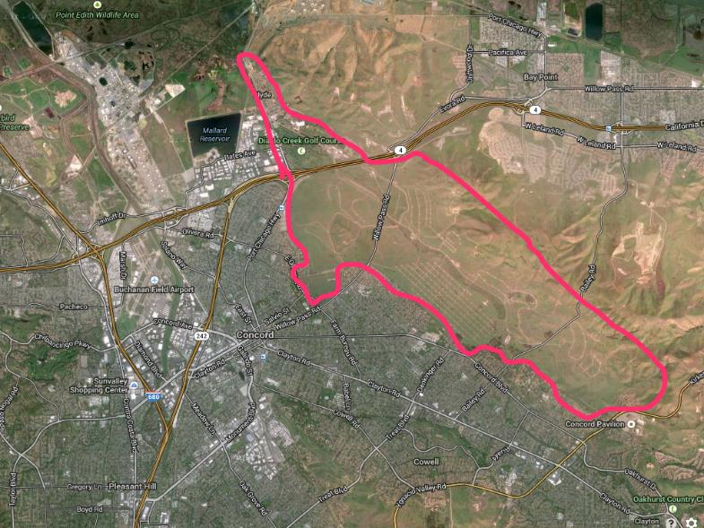
Phase I – SAV Testing Plan

Slide 27
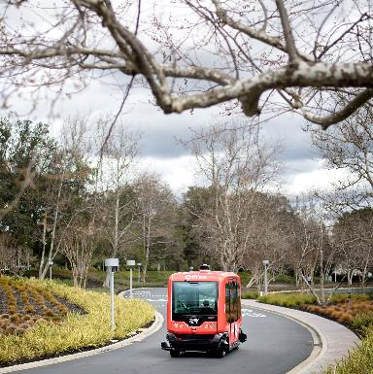
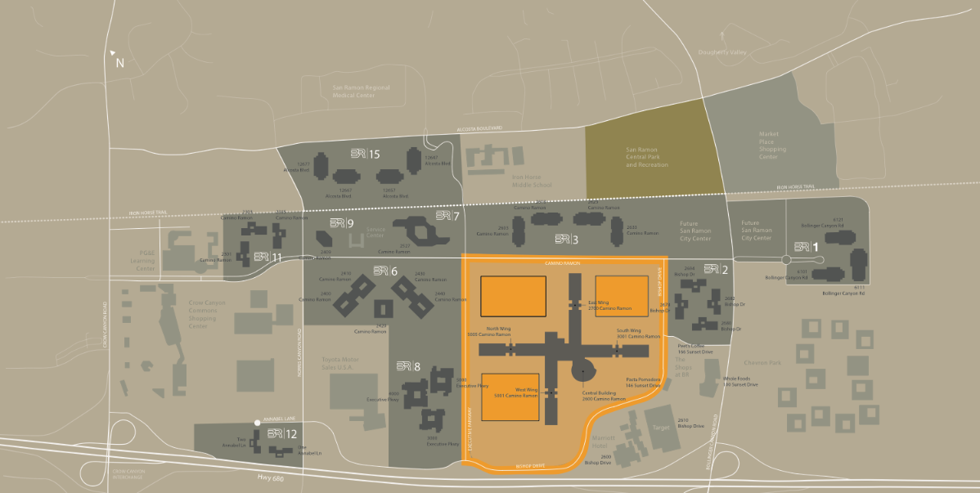
Phase II – SAV Testing Plan
Phase II (a)
Confined Environment of Bishop Ranch, San Ramon

Slide 28
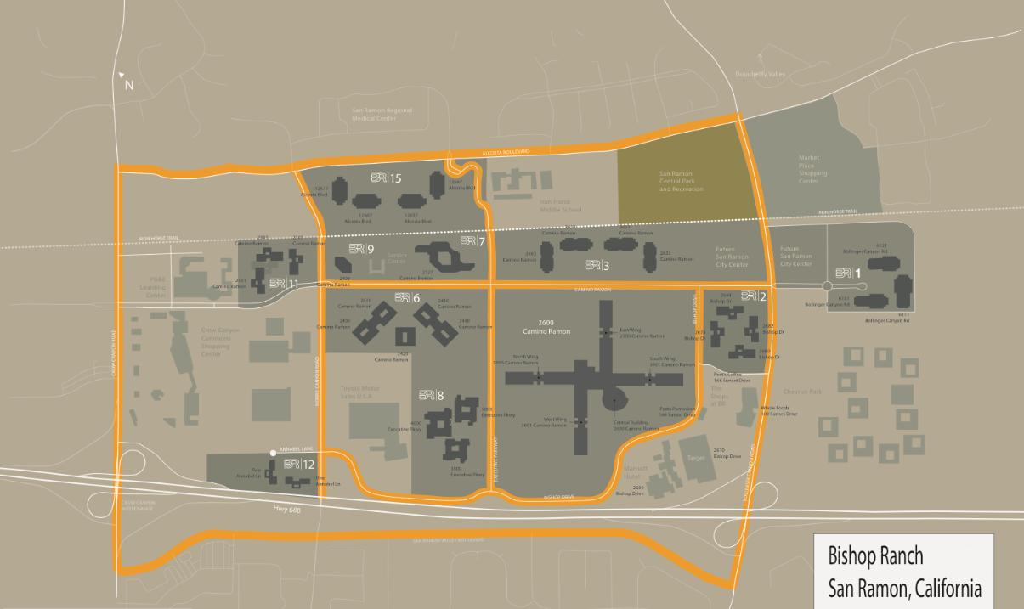
Phase II – SAV Testing Plan
Phase II (b) Public Roads of Bishop Ranch

Slide 29
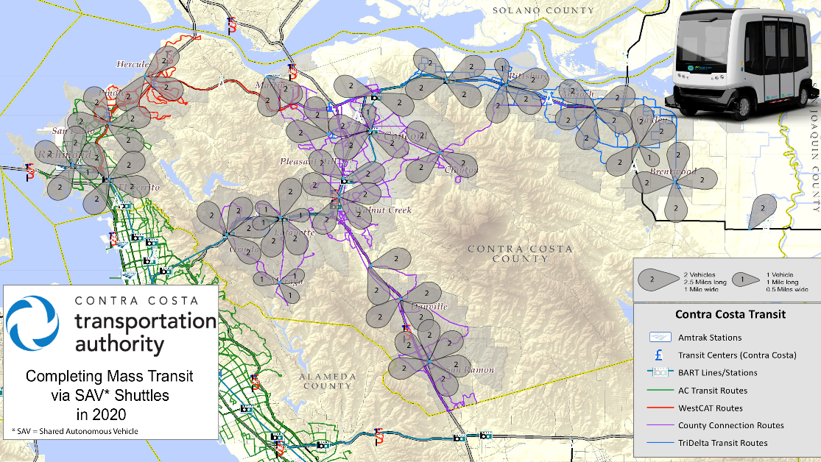
Phase III – Implementation
EasyMile SAV

Slide 30
Significant GoMentum Station Accomplishments
JAN 2017: Designated as US-DOT AV Proving Grounds
2015-2016: Strategic Plan, Business Plan and Communications Plan
SEP 2016: AB 1592 signed by Governor
APR 2017: 3rd Global Summit
2014
2015
2016
2017
2015: Signed MOU with Honda and other OEMs
2014: CCTA and GoMentum P3 at CNWS
MAR 2017: SAV
Testing at GoMentum
MAY 2017: SAV demonstration at Bishop Ranch
MAR 2015: 1st Global Summit
MAR 2016: 2nd Global Summit
JUL 2016: Launched first SAV Program in North America
NOV 2016: CCTA and GoMentum Execute MOU

Slide 31
Major Recent Accomplishments
Secured $3.5M funding from state
Signed Agreement with Toyota Research Institute
Signed Agreement with SAIC-USA of China
Signed Agreement with Sumitomo Electronic Industries
Signed Agreement with AAA
Agreement with LAVTA and County Connection in progress
$100M THUD appropriation for Autonomous Vehicles

Slide 32
20I
8
redefining
MOBILITY
SUMMIT
March 29
Be there.

Slide 33
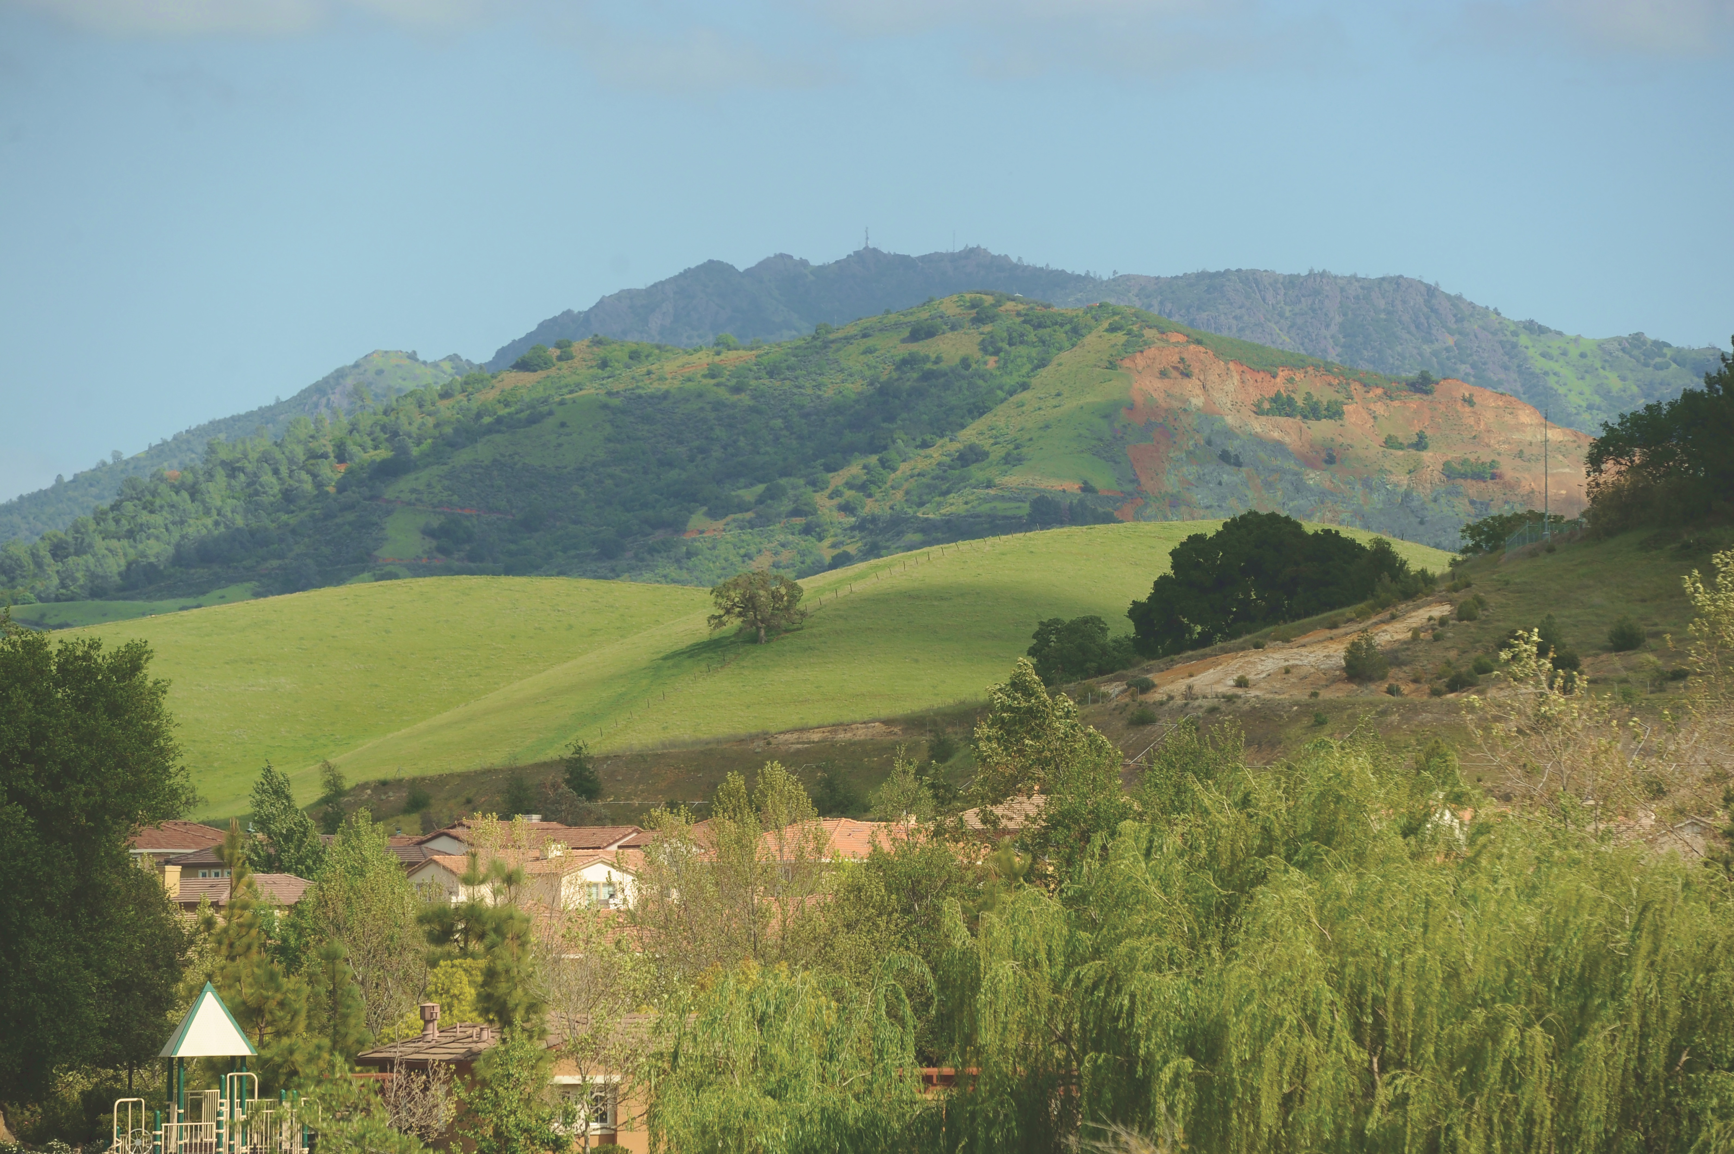
Questions and Answers

